Slide 1

Wireless Wide-Area Network (WWAN)
Seamless Global Connectivity: Covering Vast Geographical Areas
Course Title:Wireless Communication
Supervised by:
Dr. Nazrul Islam,
Associate Professor,
Dept. of ICT, MBSTU
Presented by:
Niloy Sarkar Uthso
ID: IT-21012
4th year 2nd semister
Department of Information and Communication Technology
Mawlana Bhashani Science and Technology University (MBSTU)

Slide 2

Introduction to Wireless Wide-Area Network (WWAN)
Definition and Scope
Key Infrastructure
Core Function
WWAN is a telecommunications network covering a vast geographical area, spanning cities, countries, or the entire globe, enabling connectivity over long distances.
Primarily uses cellular technology (e.g., 4G, 5G) and radio waves transmitted via base stations (towers) to provide ubiquitous wireless access.
Facilitates mobile data, voice communication, and seamless roaming capabilities for users traveling across large service areas.
Page 2 of 10

Slide 3

Distinguishing Network Coverage: WLAN vs. MAN vs. WWAN
Understanding the scale is crucial for network deployment and selecting appropriate technologies.
1
2
WLAN (Wireless Local Area Network)
MAN (Metropolitan Area Network)
Covers a small, localized area like an office or campus. Uses technologies like Wi-Fi (802.11). Range: Tens of meters.
Spans an entire city or a large campus. Often connects multiple LANs. Range: Up to tens of kilometers.
3
WWAN (Wireless Wide Area Network)
Covers the largest areas, enabling nationwide or global connectivity. Utilizes cellular carriers. Range: Hundreds to thousands of kilometers.
Page 3 of 10

Slide 4
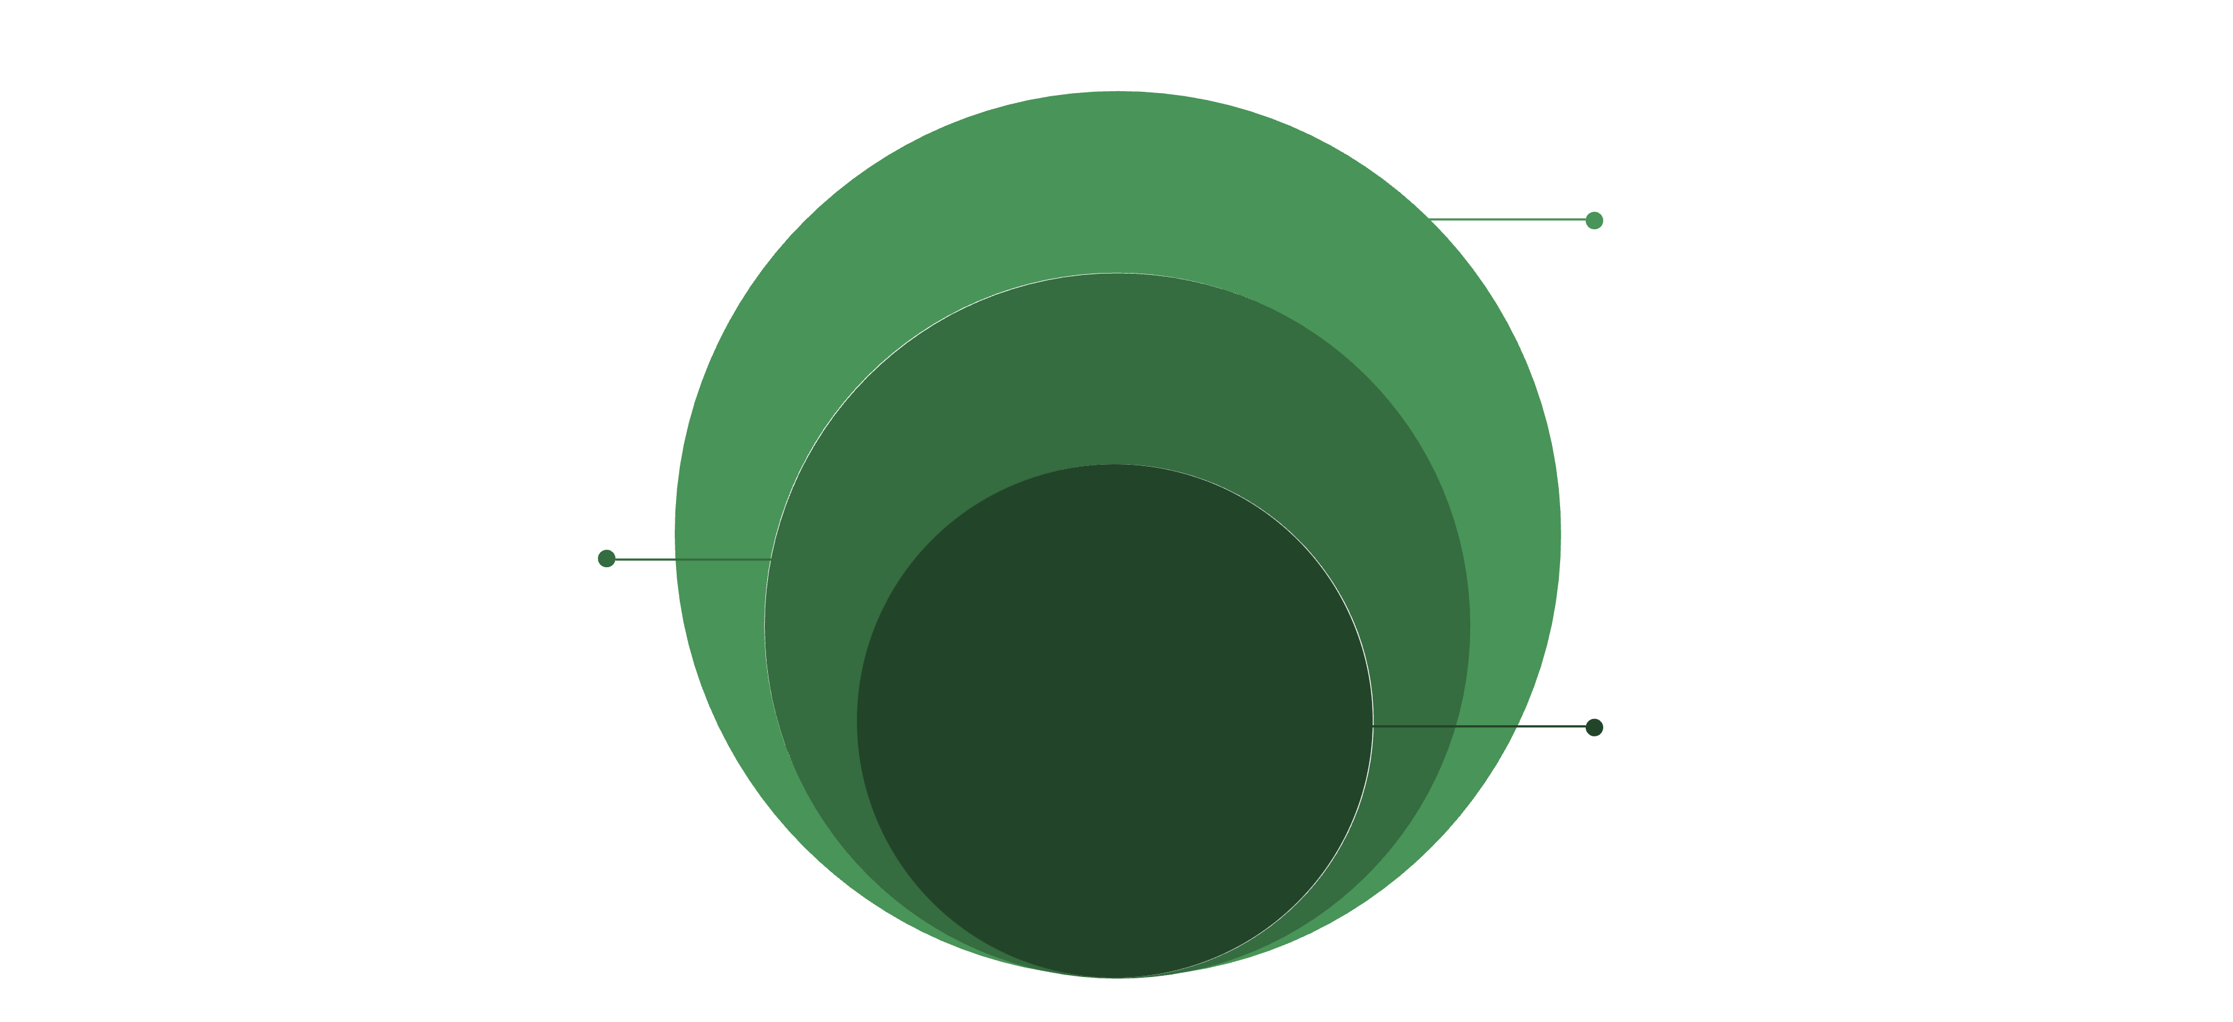
Core WWAN Architecture Overview
The architecture is layered and distributed, designed for scalability and handover efficiency.
Core & External Networks
CN functions and Internet/PSTN connectivity
Radio Access Network
Base stations and radio links
User Equipment
Mobile devices initiating connections
User Equipment (UE): Mobile devices (smartphones, laptops, IoT devices) that initiate the connection.
Radio Access Network (RAN): The base stations (e.g., gNBs in 5G) and controllers that manage the radio link to the UE.
Core Network (CN): Manages subscribers, security, billing, and mobility, directing traffic between the RAN and external networks.
Page 4 of 10

Slide 5




Mechanism of WWAN Operation
WWAN leverages complex handshaking protocols and radio resource management for continuous service.
2. Authentication & Handshake
1. Device Registration
Mobile device searches for the nearest Base Station and registers with the network's Core.
Network verifies the user (SIM card) and establishes a secure, dedicated communication channel.
4. Mobility Management
3. Data Transmission
As the device moves, the network ensures a seamless "handover" of the connection from one Base Station to the next without interruption.
Data packets are sent via radio frequency between the device and the Base Station, routed through the Core Network.
Page 5 of 10

Slide 6
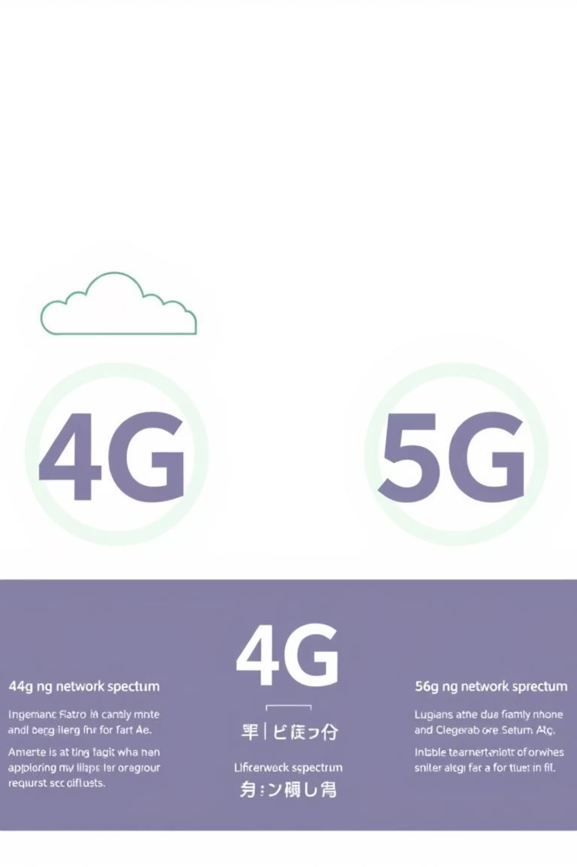
Key Types of WWAN Technologies
Evolutionary standards drive increased bandwidth, reduced latency, and greater capacity.
3G (UMTS)
1
Introduced mobile broadband data and enhanced multimedia capabilities. Focused on voice and basic data.
2
4G & LTE
High-speed data (up to 100 Mbps) for a true mobile internet experience. Key for streaming and mobile applications.
5G
3
Next-generation technology with extremely high speeds, ultra-low latency, and massive device connectivity (mMTC).
4
Satellite WWAN
Uses orbiting satellites (e.g., LEO constellations like Starlink) to provide global coverage, especially in remote areas.
Page 6 of 10

Slide 7

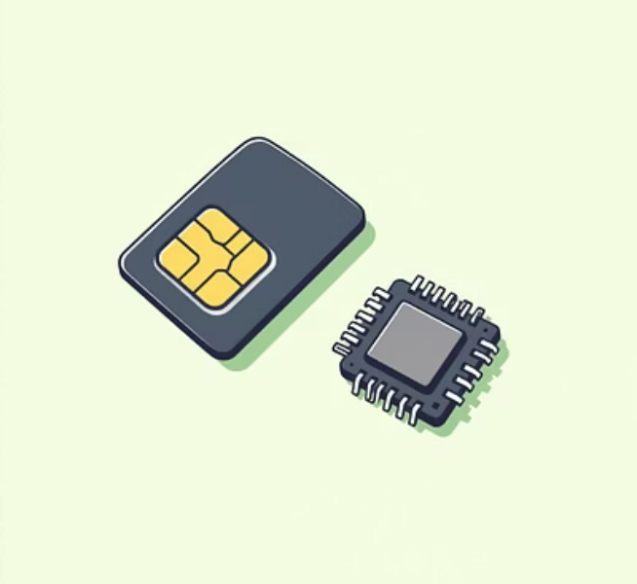
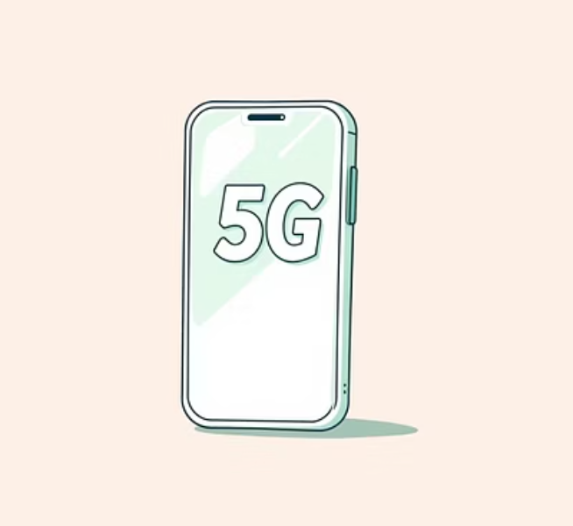
Essential Components and Devices in WWAN
Infrastructure Side
Base Stations (e.g., eNodeBs, gNBs): Transmit and receive radio signals.
Switching Centers (MSC/MME): Manage call routing, handover, and network access control.
Antennas and Backhaul: Provide robust signal coverage and connection to the Core Network (often fiber optic).
User Side
WWAN Modems: Integrated chips in devices that translate digital data into radio signals.
SIM Cards: Identifies the subscriber and manages authentication protocols.
Mobile Routers: Share a single WWAN connection across multiple devices (Mi-Fi).
Page 7 of 10

Slide 8
WWAN Advantages and Limitations
Key Advantages
Inherent Limitations
Ubiquity and Mobility
Higher Latency
Provides continuous network access while users are in transit across massive areas.
Compared to fixed-line networks, long-distance signal travel often results in higher network delays.
High Scalability
Congestion Sensitivity
Can support millions of simultaneous users and devices within the network infrastructure.
Performance can degrade significantly during peak usage times due to limited radio spectrum.
Standardization
Coverage Gaps
Global standards (3GPP) ensure compatibility and seamless international roaming.
Signal availability can be inconsistent in extremely rural, mountainous, or underground areas.
Page 8 of 10

Slide 9
Applications and Emerging Use Cases
WWAN is the backbone of the modern digital economy and next-generation services.
Global Connectivity
Massive IoT Deployment
Enables continuous access for remote workers, travelers, and disaster relief efforts.
Supports millions of low-power sensors and devices (e.g., smart agriculture, asset tracking) via technologies like NB-IoT.
Mobile Data Consumption
Connected Vehicles (V2X)
Facilitates high-definition video streaming, online gaming, and large-file transfers on the go.
Essential for Vehicle-to-Everything communication, supporting autonomous driving and enhanced traffic management.
Page 9 of 10

Slide 10

Future Trajectories: 5G and Beyond
The future of WWAN is defined by faster speeds, lower latency, and greater integration with satellite and local networks.
5G Advancements
Non-Terrestrial Networks (NTN)
Deployment of millimeter wave (mmWave) for hyper-local, gigabit speeds in urban centers, and Network Slicing for dedicated service quality.
Integration of LEO (Low Earth Orbit) satellites to expand WWAN coverage to oceans, airlines, and previously unconnected regions globally.
Edge Computing
Moving data processing closer to the user within the WWAN Core, drastically reducing latency for real-time applications like AR/VR.
Page 10 of 10
Card 10 of 10

Slide 11




Summary & Next Steps
Conclusion & References
WWAN's Critical Role
Future Research Directions
WWAN technology is indispensable for the interconnected digital age, providing the foundation for everything from personal communication and navigation to remote industrial operations and global surveillance.
Focus areas include optimizing 6G network architectures, enhancing spectrum efficiency, improving security protocols for IoT devices, and implementing AI/ML for dynamic network management.
References for Further Study
Goldsmith, A. (2005). Wireless Communications. Cambridge University Press.
Rappaport, T. S. (2002). Wireless Communications: Principles and Practice (2nd ed.). Prentice Hall.
3GPP Technical Specifications (www.3gpp.org) for current mobile network standards.
Thank You
Thank you for your attention. We encourage MBSTU ICT students to explore the vast opportunities in global network architecture and communication technologies.

